Slide 1

Tree Data Structures
Alemitu Mequanint
Addis Ababa Science & Technology University (AASTU)

Slide 2
Classification of Data Structures
Linear Data Structure
Array
Linked List
Stack
Queue
Non-Linear Data Structure
Tree
Graph

Slide 3
Trees Data Structures
Tree
  A way of representing hierarchical data
  Consist of nodes with a parent-child relationship
  Each node can have 0 or more children
  A node can have at most one parent

Slide 4
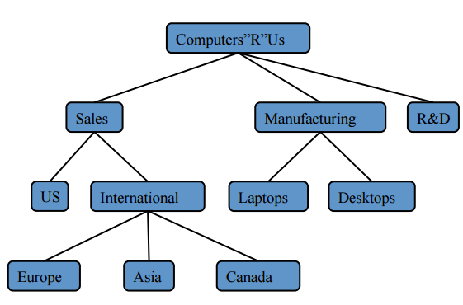

Example
Electronics Company

Slide 5
Some Applications of Tree in Computer Science!
Storing naturally hierarchical data- File system.
Organize data for quick search, insertion, deletion- Binary search tree.
Dictionary
Network Routing Algorithm.
etc.

Slide 6
Tree Terminology
Root node - a node which has no parent.
Internal node – which has at least one child
Leaf node - which has no child
Ancestor- nodes which are parent, grandparent, grand-grand-parent, etc.
Depth of a node: means number of ancestors
Height of a tree: maximum distance from root to leaf
Descendent nodes: child, child-of-child etc.

Slide 7
Tree Terminology
  Root ⇒ no parent
  Leaf ⇒ no child
  Interior ⇒ non-leaf
  Height ⇒ distance from root to leaf
Root node
Interior nodes
Height
Leaf nodes

Slide 8
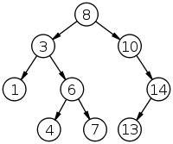
Example of a Tree
No. of nodes = 9
Height = 4
Highest Level = 3
Root Node = 8
Leaves = 1,4,7,13
Interior Nodes = 3,10,6,14
Ancestors of 6 = 3,8
Descendants of 10 = 14,13
Sibling of 1 = 6

Slide 9
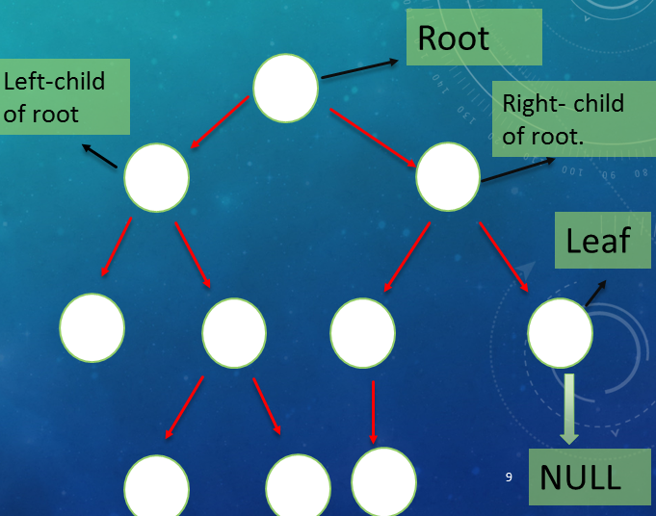
Binary Tree
  A tree in which each node has at most two children called left child and right child
  A node have only left and right child or
  Only left child or
  Only right child.
  A leaf node has no left or right child.
  A leaf node has only NULL.

Slide 10
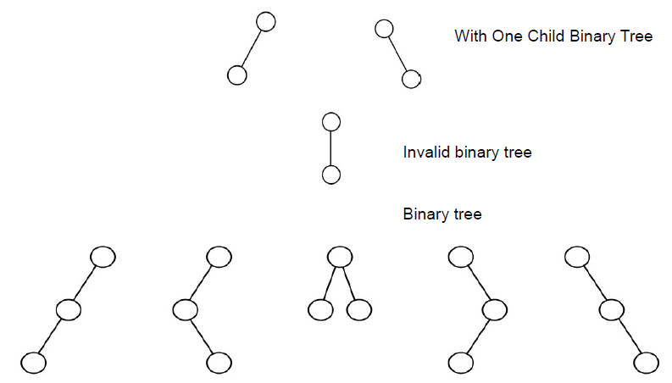
Binary Tree
Examples …

Slide 11
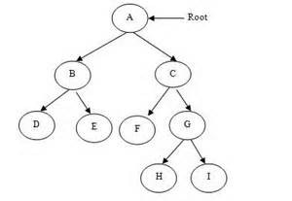
Types of Binary Tree
Strict binary tree
  Each node has exactly either two or zero child
  Every non-leaf node has non-empty left and right sub trees.
  A strictly BT with n leaves always contains '2n-1' nodes

Slide 12
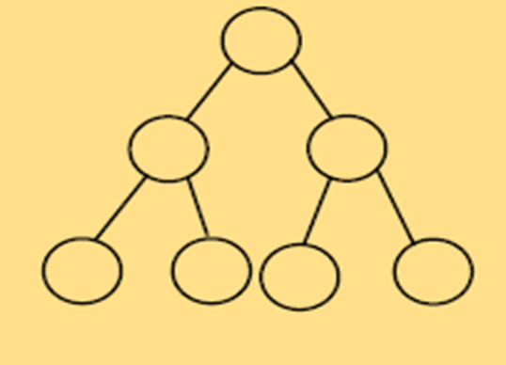
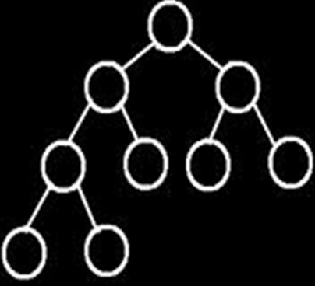
Types of Binary Tree
Complete binary tree
  a binary tree in which the length from the root to any leaf node is either h or h-1 where h is the height of the tree.
  The deepest level should also be filled from left to right
Balanced binary tree
  a binary tree where each node except the leaf nodes has left and right children and all the leaves are at the same level.

Slide 13
Binary Search Trees (Ordered binary tree)
A binary search tree is either empty or in which every node contains a key and satisfied the conditions:
The key in the left child of a node (if it exist) is less then the key in its parent node.
The key in the right child of a node (if it exist) is greater then the key in its parent node.
The left and right sub-trees of the root are again binary search trees.
No two entries in a binary search tree may have a equal keys.

Slide 14
Binary Search Trees
In short:
  Value at node
    Smaller values in left sub-tree
    Larger values in right sub-tree
  Example
    X > Y
    X < Z
Value of all the nodes in left sub-tree is Lesser.
Value of all the nodes in right sub-tree is greater.
X
Y
Z

Slide 15
Binary Search Trees
Examples
10>25?, False
30>45?, False
5
10
10
2
45
5
30
5
45
30
2
25
45
2
25
30
10
Not a binary search tree
25
Binary search trees

Slide 16
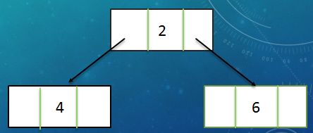
Binary Tree Implementation
(using linked list)
Tree is a data structure similar to linked list
Instead of pointing to one node each node can point to a number of nodes
Data Structure of a Binary Tree
struct node{
//declaration of data fields
node *leftChild,
node *rightChild;
};
node *rootPtr = NULL;
struct node{
int key;
node *left,
node *right;
};
node *rootPtr=NULL;
Example:

Slide 17
Data Structure of Generic Tree (N-ary) Tree
Each node can have no child , one child , two child or more than two child -called generic tree, tree of a general kind.
How to design data structure for such a tree?
Possible solution may be:
struct node{
int data;
node *firstchild;
node *secondchild;
node *threechild;
node *fourchild;
node *fivechild;
};
node *rootPtr
…But wait, this structure has problem?

Slide 18

We don’t know the exact number of children for each node
  Wastage of memory by allocating extra child since we are not using all the pointers in all the cases.
Possible solution is:
  At each node there should be a link between all the children of same parent (sibling)
  Also, remove all the link from parent to their child except first child
struct node{
int data;
node *firstchild;
node *nextsibling;
};
node *rootPtr = NULL;

Slide 19
Operations on Binary Search Tree
Basic Operations:
  Inserting an element into tree
  Deleting an element from tree
  Searching for an element
  Traversing the tree
Auxiliary operations:
  Finding – size of tree, height of tree, etc

Slide 20
BST – Insertion
When a node is inserted the definition of binary search tree should be preserved!
Suppose:
      rootPtr -points to root node
      newPtr -points new node
Case 1: There is no data in the tree
      (i.e. rootPtr is NULL)
      The node pointed by newPtr should be made the root node.
Case 2: There is data
      Search the appropriate position.
      Insert the node in that position.

Slide 21
Pseudocode:
  Perform search for value X
  Search will end at node Y (if X not in tree)
  If X < Y, insert new leaf X as new left sub-tree for Y
  If X > Y, insert new leaf X as new right sub-tree for Y
  Insertions may unbalance tree

Slide 22
Algorithm
1. Input the data to be pushed and root node of the tree.
2. newPtr = Create a New Node, parentPtr = rootPtr
3. If (parentPtr == NULL)
  parentPtr = newPtr
4. Else if (data < parentPtr ->info) //parentPtr ->info :data part
    parentPtr = parentPtr->left
    GoTo Step 4
5. Else if (data > parentPtr->info)
    parentPtr = parentPtr->right
GoTo Step 4
6. If (data< parentPtr->info)
    parentPtr->Left = newPtr
7. Else if (data > parentPtr->info)
parentPtr ->right = newPtr

Slide 23
Algorithm…
8. Else
display (“duplicate node”)
exit
9. newPtr->info = data
10. newPtr->left = NULL
11. newPtr->right = NULL
12. exit

Slide 24
Example
Insert ( 20 )
10
10 < 20, right
30 > 20, left
25 > 20, left
Insert 20 on left
5
30
2
25
45
20

Slide 25
BST – Deletion
Algorithm
  Perform search for value X
  If X is a leaf, delete X
  Else // must delete internal node
    a) Replace with largest value Y on left subtree
    OR smallest value Z on right subtree
    b) Delete replacement value (Y or Z) from subtree

Slide 26
Example Deletion (Leaf)
Delete ( 25 )
10
10
10 < 25, right
30 > 25, left
25 = 25, delete
5
30
5
30
2
25
45
2
45

Slide 27
Example Deletion (Internal node)
Delete ( 10 )
10
5
5
5
30
5
30
2
30
2
25
45
2
25
45
2
25
45
Replacing 10 with largest value in left subtree
Replacing 5 with largest value in left subtree
Deleting leaf

Slide 28
Example Deletion (Internal node)
Delete ( 10 )
10
25
25
5
30
5
30
5
30
2
25
45
2
25
45
2
45
Replacing 10 with smallest value in right subtree
Deleting leaf
Resulting tree

Slide 29
BST- Search
node *find( node *n, int key) {
while (n != NULL) {
if (n->data == key) // Found it
return n;
if (n->data > key) // In left subtree
n = n->left;
else // In right subtree
n = n->right;
}
return null;
}
//call function
node * n = find( root, 5);

Slide 30
Example Search
find ( root, 2 )
root
10
5
10 > 2, left
5 > 2, left
2 = 2, found
5 > 2, left
2 = 2, found
5
30
2
45
2
25
45
30
10
25

Slide 31
Example Search
find (root, 25 )
10
5
10 < 25, right
30 > 25, left
25 = 25, found
5 < 25, right
45 > 25, left
30 > 25, left
10 < 25, right
25 = 25, found
5
30
2
45
2
25
45
30
10
25

Slide 32
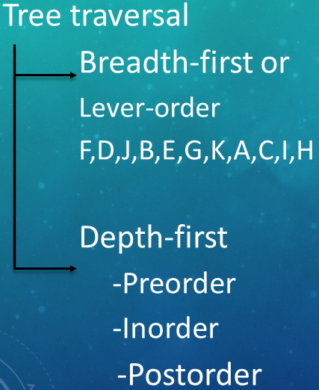
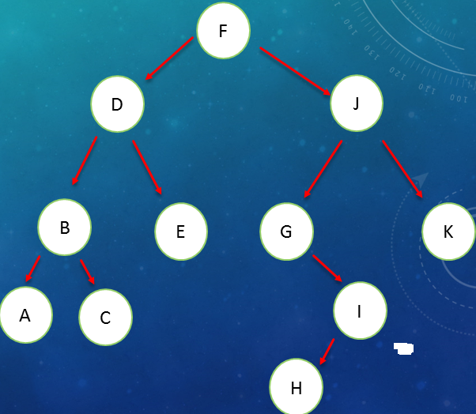
Traversing Binary trees
Tree traversal is one of the most common operations performed on tree data structures.
It is a way in which each node in the tree is visited exactly once in a systematic manner.
Level - order

Slide 33
Depth first…
Pre order traversal - traversing binary tree in the order of parent, left and right (PLR).
In order traversal - traversing binary tree in the order of left, parent and right (LPR).
Post order traversal - traversing binary tree in the order of left, right and parent (LRP).

Slide 34
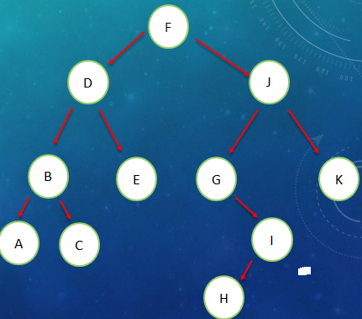
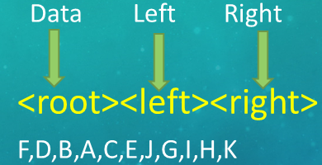
Pre Order Traversal(Recursive)
Steps:
  Visit the root node
  Traverse the left sub tree in preorder
  Traverse the right sub tree in preorder
PLR

Slide 35
Pre Order Traversal(Recursive)
PLR
void preorder (node *CurrNodePtr){
if(CurrNodePtr ! = NULL) {
cout<< CurrNodePtr->data; // or any operation
preorder(CurrNodePtr->left);
preorder(CurrNodePtr->right);
}
}
+
- %
A * * 4
/ 2 D 5
C 5
Output: + - A * / C 5 2 % * D 5 4

Slide 36
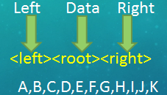
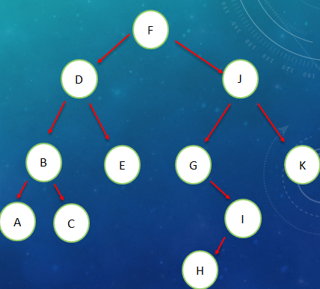
In Order Traversal (Recursive)
Steps:
Traverse the left sub tree in-order
Visit the root node
Traverse the right sub tree in-order
LPR
[The left sub tree is traversed recursively, before visiting the root. After visiting the root the right sub tree is traversed recursively, in order fashion.]

Slide 37
In Order Traversal (Recursive)
LPR
void inorder (node *CurrNodePtr){
if(CurrNodePtr ! = NULL){
inorder(CurrNodePtr->left);
cout<< CurrNodePtr->data;
inorder(CurrNodePtr->right);
}
}
+
- %
A * * 4
/ 2 D 5
C 5
Output: A – C / 5 * 2 + D * 5 % 4

Slide 38
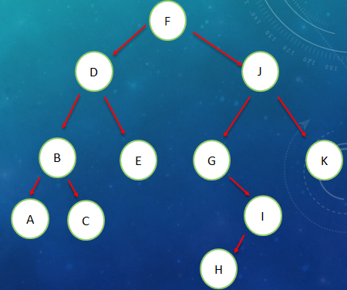
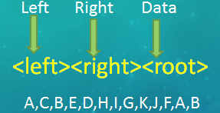
Post Order Traversal (Recursive)
LRP
Steps:
  Traverse the left sub tree in post order
  Traverse the right sub tree in post order
  Visit the root node

Slide 39
Post Order Traversal (Recursive)
LRP
void postorder (node *CurrNodePtr){
if(CurrNodePtr ! = NULL){
postorder(CurrNodePtr->left);
postorder(CurrNodePtr->right);
cout<< CurrNodePtr->data;
}
}
+
- %
A * * 4
/ 2 D 5
C 5
Output: A C 5 / 2 * - D 5 * 4 % +

Slide 40
Reading Assignment . . .
(textbook)
Heaps and Priority Queues
Huffman Coding Trees

